Slide 1

Peter Andreas Grünberg
Born: 18 May 1939, Pilsen
Died: 7 April 2018
Profession: Physicist
Education: Goethe University Frankfurt, Techni

Slide 2
Life and career
Grünberg was born in Pilsen, Bohemia, which at the time was in the German-occupied Protectorate of Bohemia and Moravia (now the Czech Republic) to the Sudeten German family of Anna and Feodor A. Grünberg which first lived in Dysina (Dýšina) to the East of Pilsen.

Slide 3
Study and Research
Grünberg received his intermediate diploma in 1962 from the Johann Wolfgang Goethe University in Frankfurt. He then attended the Darmstadt University of Technology, where he received his diploma in physics in 1966 and his Ph.D. in 1969. From 1969 to 1972, he did postdoctoral work at Carleton University in Ottawa, Canada. He later joined the Institute for Solid State Physics at Forschungszentrum Jülich, where he became a leading researcher in the field of thin film and multilayer magnetism until his retirement in 2004.

Slide 4
Notable awards
Wolf Prize in Physics (2006)
European Inventor of the Year (2006)
Japan Prize 2007
Nobel Prize in Physics (2007)

Slide 5
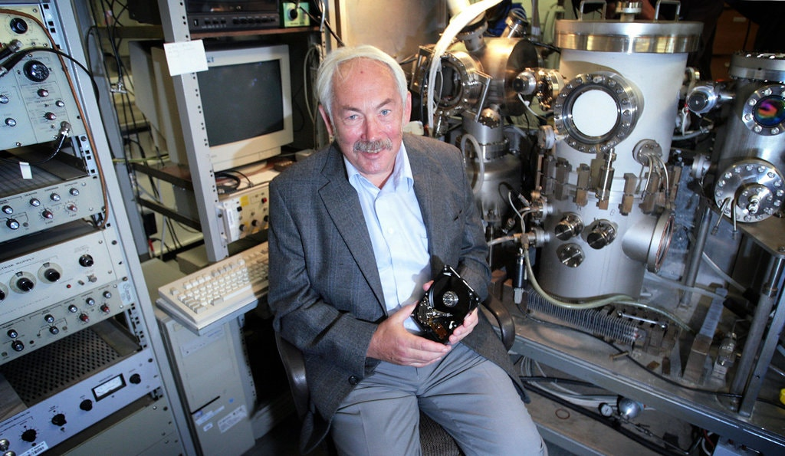
Peter Grünberg, 78, Winner of an ‘iPod Nobel,’
Peter Grünberg, a Nobel-Prize-winning physicist who discovered how to store vast amounts of data by manipulating the magnetic and electrical fields of thin layers of atoms, making possible devices like the iPad and the smartphone
“The MP3 and iPod industry would not have existed without this discovery,” Börje Johansson of the Swedish Royal Academy said when the Nobel was announced. “You would not have an iPod without this effect.”

Slide 6
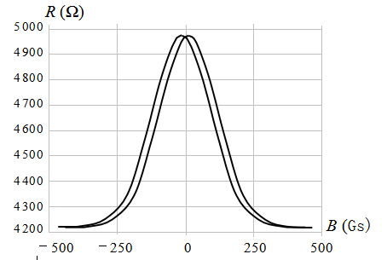
The Discovery of the Giant Magnetoresistance (GMR)
The Giant Magnetoresistance was independently discovered in 1988 by Peter Andreas Grunberg of the Yulich Research Center in Germany and by Albert Fert of the Eleventh University in Paris. They jointly won the 2007 Nobel Prize in Physics.
In the initial work, Peter Andreas Grunberg's research team only studied structural materials composed of three layers of iron, chromium and iron. Their experimental results showed that the electrical resistance value was decreased by 1.5%. While Albert Fert 's team studied multilayer materials made of iron and chromium, which reduced the resistance value by 50%

Slide 7

What is the giant magnetoresistance (GMR)?
The Giant Magnetoresistance (GMR) refers to the phenomenon in which the electrical resistivity of a magnetic material changes greatly when it has an external magnetic field as compared with the absence of an external magnetic field.
It is a quantum mechanical effect that results from a layered magnetic thin film structure. This structure is formed by alternately laminating thin layers of ferromagnetic material and non-ferromagnetic material. When the magnetic moments of the ferromagnetic layers are parallel to each other, the carrier-dependent scattering is minimal and the material has the smallest resistance.
When the magnetic moment of the ferromagnetic layer is anti-parallel, the spin-related scattering is the strongest and the resistance value of the material is the largest.

Slide 8
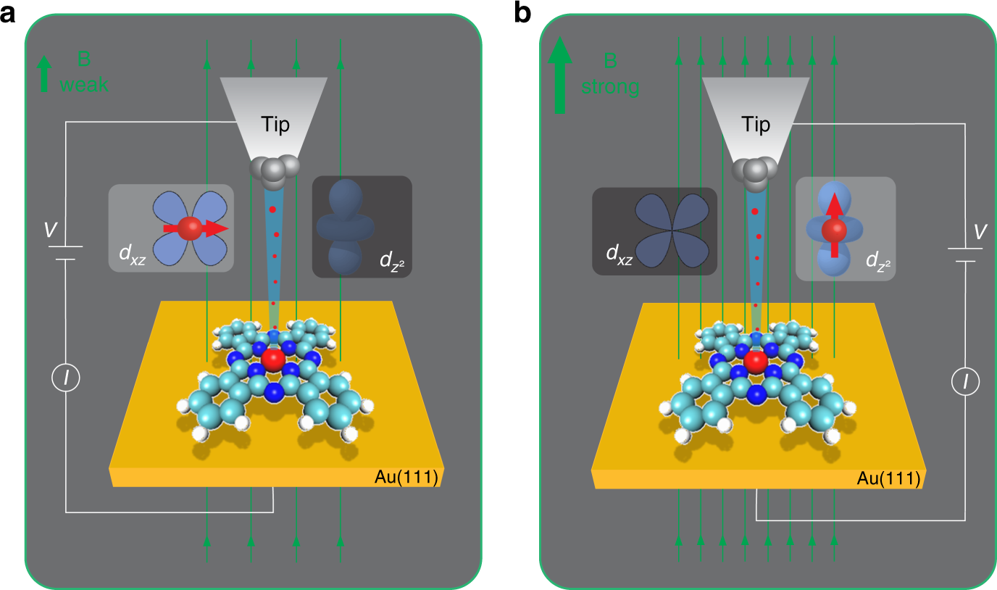
The Features of the Giant Magnetoresistance (GMR)
The resistance value of the structure material is related to the magnetization direction of the ferromagnetic thin film. The resistance value of the two layers of magnetic material in opposite magnetization direction is obviously larger than that of the same magnetization direction. The resistance varies greatly under very weak external magnetic field.
Application : Semiconductor Industries

Slide 9
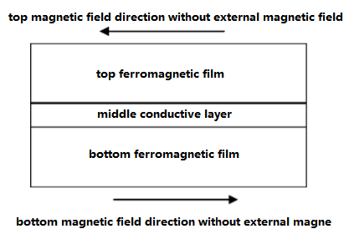
The Principle of the Giant Magnetoresistance (GMR)
According to the microscopic mechanism of conduction, the electrons in the metals do not travel straight along the electric field when conducting electricity, but continuously collide with the atoms in the lattice position (also called scattering), and the electrons change the direction of motion after each scattering. The motion is the superposition of the directional acceleration of the electric field on the electrons. After each scattering, electrons will change their direction of motion. The average distance of the electrons moving between the two scatterings is called the mean free path. The smaller the probability of electron scattering is, the longer the mean free path is and the lower the resistivity is.

Slide 10
THANK YOU
GROUP 3 CSE AI&ML BATCH 5
ROHIT GAUTAM (149)
ROHIT VIJAY (150)

